Slide 1

8.4 布尔表达式的翻译
E→E or E | E and E | not E | (E) | id relop id | true | false
8.4.1 两种翻译方式
数值编码：0－false，非0－ture
控制流语句 属性true——布尔表达式为真时跳转到的程序位置 属性false——布尔表达式为假时跳转到的程序位置
短路求值
E₁ or E₂，E₁=false才对E₂求值
注意副作用问题：函数调用

Slide 2
8.4.2 用数值表示布尔值
a or b and not c ➔
t₁ := not c
t₂ := b and t₁
t₃ := a or t₂
a < b ➔ if a < b then 1 else 0
100: if a < b goto 103
101: t := 0
102: goto 104
103: t := 1
104:

Slide 3

翻译模式
E→E₁ or E₂ { E.place = newtemp;
emit(E.place ‘:=’ E₁.place ‘or’ E₂.place); }
E→E₁ and E₂ { E.place = newtemp;
emit(E.place ‘:=’ E₁.place ‘and’ E₂.place); }
E→not E₁ { E.place = newtemp;
emit(E.place ‘:=’ ‘not’ E₁.place); }
E→( E₁ ) { E.place = E₁.place; }
E→id₁ relop id₂ { E.place = newtemp;
emit(‘if’ id₁.place relop.op id₂.place ‘goto’ nextstat + 3);
emit(E.place ‘:=’ ‘0’);
emit(‘goto’ nextstat + 2);
emit(E.place ‘:=’ ‘1’); }
E→true { E.place = newtemp; emit(E.place ‘:=’ ‘1’); }
E→false { E.place = newtemp; emit(E.place ‘:=’ ‘0’); }

Slide 4

例8.3
翻译a < b or c < d and e < f
100: if a < b goto 103 107: t₂ := 1
101: t₁ := 0 108: if e < f goto 111
102: goto 104 109: t₃ := 0
103: t₁ := 1 110: goto 112
104: if c < d goto 107 111: t₃ := 1
105: t₂ := 0 112: t₄ := t₂ and t₃
106: goto 108 113: t₅ := t₁ or t₄

Slide 5
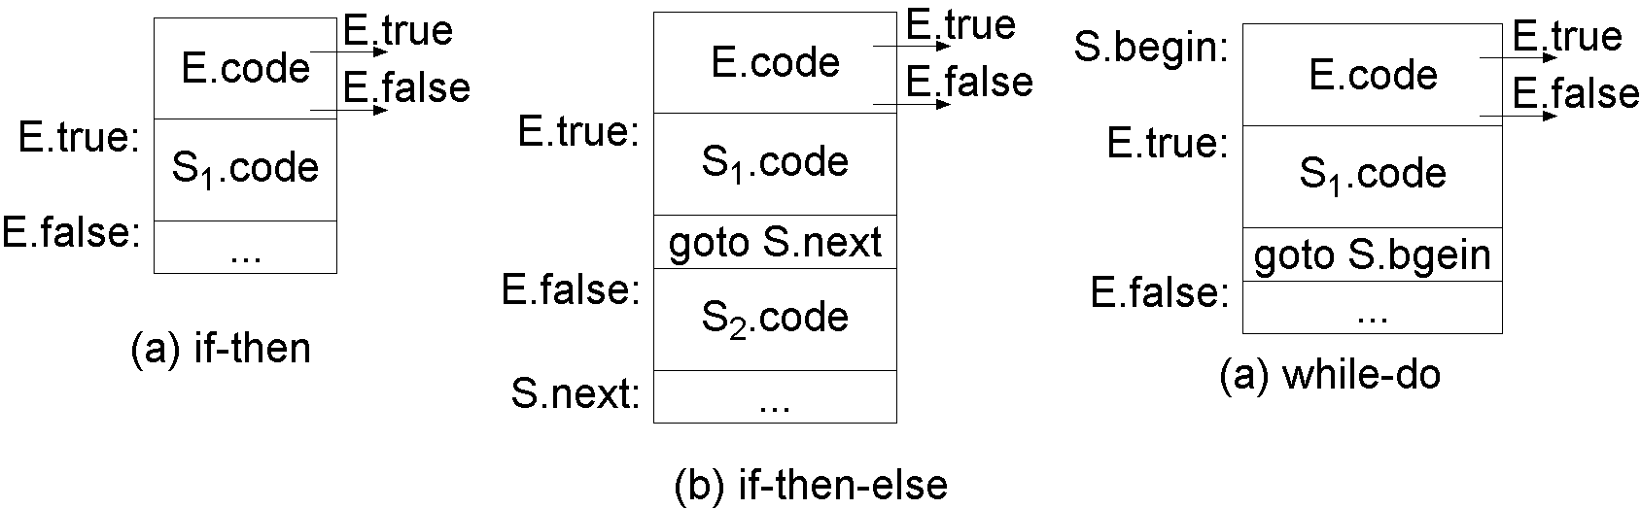
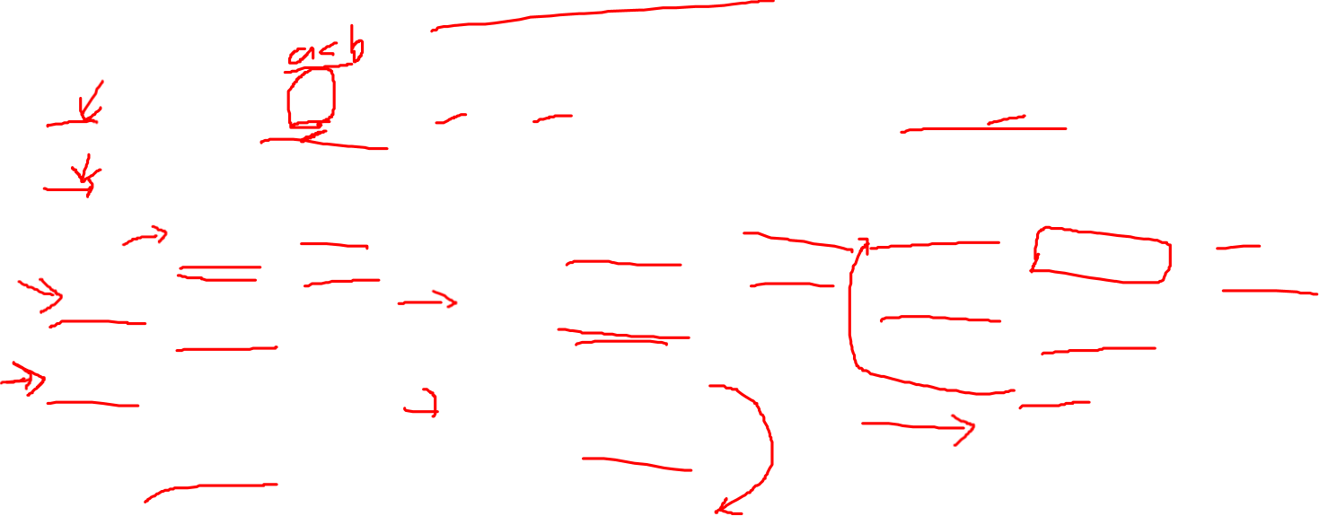
8.4.3 控制流语句的翻译
S→if E then S₁ | if E then S₁ else S₂ | while E do S₁

Slide 6
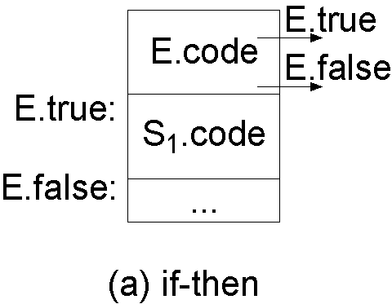

语法制导定义－if
S→ if E then S₁ E.true = newlabel; E.false = S.next;
S₁.next = S.next;
S.code = E.code || gen(E.true ‘:’) || S₁.code

Slide 7
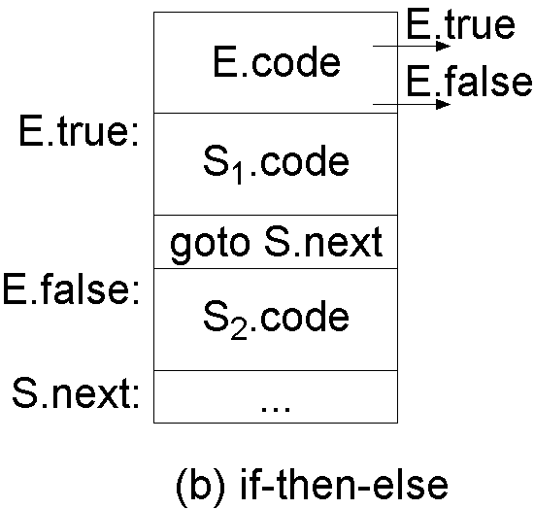
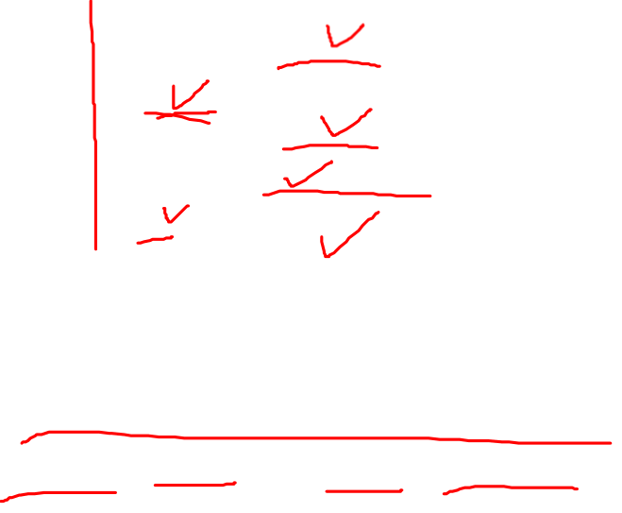
语法制导定义－if-else
S→if E then S₁ else S₂
E.true = newlabel; E.false = newlabel;
S₁.next = S.next; S₂.next = S.next;
S.code = E.code || gen(E.true ‘:’) || S₁.code
|| gen(‘goto’ S.next) || gen(E.false ‘:’) ||S₂.code

Slide 8
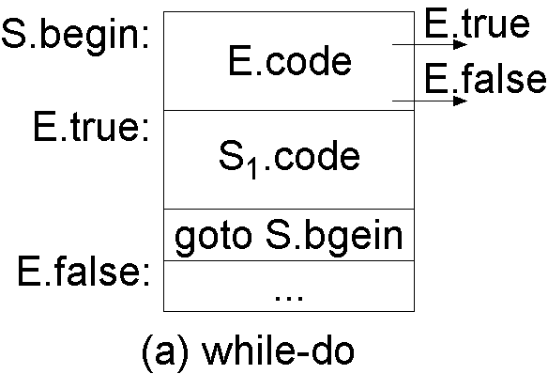

语法制导定义
S→while E do S₁
S.begin = newlabel; E.true = newlabel;
E.false = S.next; S₁.next = S.begin;
S.code = gen(S.being ‘:’) || E.code || gen(E.true ‘:’) ||
S₁.code || gen(‘goto’ S.begin)

Slide 9

8.4.5 布尔表达式翻译为控制流语句
E→E₁ or E₂ E₁.true = E.true; E₁.false = newlabel;
E₂.true = E.true; E₂.false = E.false;
E.code = E₁.code || gen(E₁.false ‘:’) || E₂.code
E→E₁ and E₂ E₁.true = newlabel; E₁.false = E.false;
E₂.true = E.true; E₂.false = E.false;
E.code = E₁.code || gen(E₁.true ‘:’) || E₂.code
E→not E₁ E₁.true = E.false; E₁.false = E.true; E.code = E₁.code;
E→( E₁ ) E₁.true = E.true; E₁.false = E.false; E.code = E₁.code;
E→id₁ relop id₂ E.code = gen(‘if’ id₁.place relop.op id₂.place
‘goto’ E.true) || gen(‘goto’ E.false)
E→true E.code = gen(‘goto’ E.true);
E→false E.code = gen(‘goto’ E.false);

Slide 10
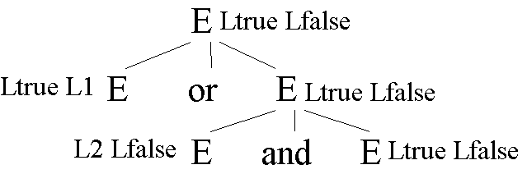

例8.4
a < b or c < d and e < f
生成代码：
if a < b goto Ltrue
goto L1
L1: if c < d goto L2
goto Lfalse
L2: if e < f goto Ltrue
goto Lfalse

Slide 11
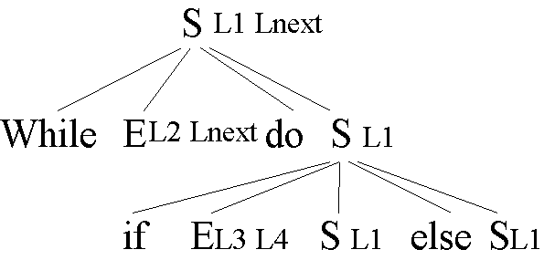

例8.5
while a < b do
if c < d then
x := y + z
else
x := y – z
生成代码为：
L1: if a < b goto L2 L4: t₂ := y - z
goto Lnext x := t₂
L2: if c < d goto L3 goto L1
goto L4 Lnext:
L3: t₁ := y + z
x := t₁
goto L1

Slide 12

8.4.6 混合翻译方式
E→E + E | E and E | E relop E | id
E→E₁ + E₂对应的语义规则为：
E.type = arith;
if (E₁.type = arith and E₂.type = arith) {
E.place = newtemp;
E.code = E₁.code || E₂.code || gen(E.place ‘:=’ E₁.place ‘+’ E₂.place);
} else if (E₁.type = arith and E₂.type = bool) {
E.place = newtemp; E₂.true = newlabel; E₂.false = newlabel;
E.code = E₁.code || E₂.code ||
gen(E₂.true ‘:’ E.place ‘:=’ E₁.place + 1) ||
gen(‘goto’ nextstat + 1) ||
gen(E₂.false ‘:’ E.place ‘:=’ E₁.place)
} else if …

Slide 13

8.5 case语句的翻译
switch E
begin
case V₁ : S₁
case V₂ : S₂
…
case V_{n-1} : S_{n-1}
default : S_{n}
end
计算表达式E
寻找哪个V与E的值相等，都不等，则选择default
运行对应的语句

Slide 14

翻译方法
第(2)步是一个n-路分支
翻译为简单的条件分支语句
表驱动
表项——<值，标号>
利用一循环进行检测
hash表
直接定位
取值范围小，i_{min}~i_{max}
标号数组label[i_{max} - i_{min} + 1]
值j → 对应语句标号label[j - i_{min}]
表达式求值 → 直接定位标号

Slide 15

翻译方法1
计算E→t
goto test
L₁: S₁代码
goto next
L₂: S₂代码
goto next
…
L_{n-1}: S_{n-1}代码
goto next
L_{n}: S_{n}代码
goto next
test: if (t == V₁) goto L₁
if (t == V₂) goto L₂
…
if (t == V_{n-1}) goto L_{n-1}
goto L_{n}
next:

Slide 16

翻译方法2
计算E→t
if t <> V₁ goto L₁
S₁代码
goto test
L₁: if t <> V₂ goto L₂
S₂代码
goto next
L₂:
…
L_{n-2}: if t <> V_{n-1} goto L_{n-1}
S_{n-1}代码
goto next
L_{n}: S_{n}代码
next:

